Slide 1

Modular Construction Insurance Implications

Slide 2
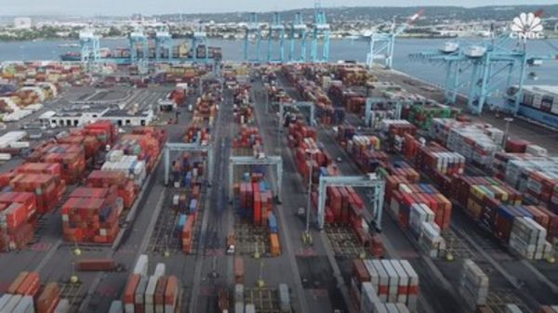
Is this the future?
How this shipping container business is attempting to flip the construction industry on its head

Slide 3
What’s it all about
Modular is not new by any means!
  It’s been around since the beginning of the 20th Century.
  It became popular mid-century with housing developments, nursing homes and military base construction.
  The Carter recession in the late 70’s saw it crash.
  National Homes Construction and V Jobst

Slide 4

Why hasn't it grown
It’s different
Trailer park mentality – substandard
Union opposition
Local union jurisdiction and work rules
Building codes

Slide 5
Construction Industry
As compelling as the advantages of digitalization are, adoption in the construction industry is slow.
For example, usage of robotics and automated systems, technologies with well-established effectiveness in other industries like manufacturing, remains at around 30 percent according to the recent study Global-Construction-Survey 2016 of global audit, tax and advisory service provider KPMG.

Slide 6
Some advantages of Modular
Jacobs continuously trains its construction professionals to help reduce risk. Most of our work is performed at or near grade from the ground, ladders, or man lifts. We separate modules on the shop floor to minimize the need for craft to work “on top” of one another and also safely work on all “faces” of a module in parallel.
Performing work indoors reduces the potential of slips and falls on wet and/or icy surfaces and shifting labor hours from site to our shop environment minimizes the potential of spills, fires, and vehicle accidents – in addition to helping avoid unnecessary congestion on site.
Jacobs' Charleston, South Carolina, U.S. facility maintains OSHA STAR VPP status, which means our injury and illness rates are well below National Bureau of Labor statistic averages and we implement effective safety and health management systems.

Slide 7
More advantages
Future trends will further increase the transformational impact of off-site construction.
BIM files will connect directly with robotized prefabrication plants producing modules.
Modules can be fitted with electronic “chips” costing less than a dollar and connected to BIM via the IoT.
This allows these components to be delivered and installed correctly (alerting site managers when being installed incorrectly), increasing efficiency and reducing costly rectification rates and building maintenance costs.

Slide 8
Issues in modular construction
Is the modular producer a sub or supplier?
Contractors are increasingly requiring suppliers to purchase product recall insurance.
Who is at risk while unit at factory or transit?
How do you schedule and who is responsible for delay? What if manufacturer defaults?
Will there be a warrantee and who will provide it?

Slide 9
Legal issues
If the provision of goods is the predominant factor, then the party to the contract is a manufacturer under the contract, and the UCC applies.
If the provision of services is the predominant factor under the contract, then the party to the contract is a subcontractor

Slide 10
Property Coverage
Builders Risk – Off site and in transit coverage
Aggregate limit – multiple modules
Who covers work on the factory floor or storage?
Soft costs for delay?
What if the supply chain breaks?
Installation floater – just like pre-cast

Slide 11
Property
Is there enough insurance coverage at the facility to cover a total loss of all units in the event of a fire, natural disaster or other unforeseen event?
Does the manufacturer have the ability to separate the units from various jobs and identify which units and building parts belong to which project?

Slide 12
Professional Liability
Who designed what?
Do the modules support the structure or is there a separate support frame?
Is a project specific placement the answer?
Then how do we define the project “site”
Does Means and Methods apply?
Products Exclusion • Customized / Engineered Products

Slide 13
Work Comp
Manufactured, Mobil or Prefabricated Home Manufacturing – Shop Work – All Operations & Drivers 2797
Manufactured, Mobil or Prefabricated Home Setup, Hookup or Installation at Job Site 2799
This must include site work – not just drop off. Drop shipping should be assigned to appropriate trucking code.

Slide 14
General Liability
Is it a “product” or is it a “completed operation”?
Do we need both competed ops and vendors?
Where and when did it “occur”?

Slide 15
Illinois Products Liability
"This is not a case where defective construction created a hazard that resulted in a member of the plaintiff's family being struck by a falling brick from the chimney.
The adjoining wall has not collapsed on and destroyed the plaintiff's living room furniture.
The plaintiff is seeking damages for the costs of replacement and repair of the defective chimney, adjoining wall and patio.
While the commercial expectations of this buyer have not been met by the builder, the only danger to the plaintiff is that he would be forced to incur additional expenses for living conditions that were less than what was bargained for."

Slide 16
Controlled Insurance Program
Covers on-site activities only
  Can include dedicated fabrication
  Once project is completed, covered under Completed Ops with subrogation

Slide 17
The specifics
Project and contract details are where it’s at
Is the contractor the manufacturer?
How is risk allocated in the contact?
Is the design “unique”?

Slide 18
Does a Surety Bond apply?
One of the risks facing any construction project is the loss of a key subcontractor in the middle of the construction process. If a plumber or electrician goes out of business, there are usually other, high-quality subcontractors in the area to help fill the void.
However, there may only be a few companies capable of creating the modular units that are needed for any specific project.
That makes it particularly important for the developer or general contractor to fully vet the financial stability of any modular construction partner during the subcontractor prequalification process in order to ensure they have the materials and resources to get the job done well and on schedule.

Slide 19
Does a Surety Bond apply?
Each scenario creates its own legal risks and benefits. For instance, construction lenders may be uncomfortable with the idea that a modular construction partner is not considered a subcontractor because a performance bond provided by the general contractor may not extend to the modular construction partner.
If the contract between the general contractor and the modular construction partner is unclear on this point, the lender may have concerns about what guarantees are in place that the modular construction partner will complete its part of the project on schedule.
Contractually stipulating that the modular construction partner be treated as a subcontractor can provide some protections to both the developer and its lender that the work will be completed on time, and to the satisfaction of the general contractor.

Slide 20
The Miller Act
Third-tier and more remote subcontractors and material suppliers cannot recover against the Miller Act payment bond.
Further, a second-tier material supplier who supplied a first-tier material supplier, and not a first-tier subcontractor, likewise cannot recover under the Miller Act payment bond. See Clifford F. MacEvoy Co. v. Calvin Tomkins Co., 322 U.S. 102 (1944)

