Slide 1
Love My Tender
Love My Suit
Never Let Me Go (Bare)
How to tender a claim

Slide 2
Love My Tender
Tender of Defense. The act in which one party places its defense and all costs associated with said defense with another due to a contract or other agreement. This transfers the obligation of the defense and possible indemnification to the party to which the tender was made.
verb (used with object)1.to present formally for acceptance; make formal offer of:to tender one's resignation.

Slide 3
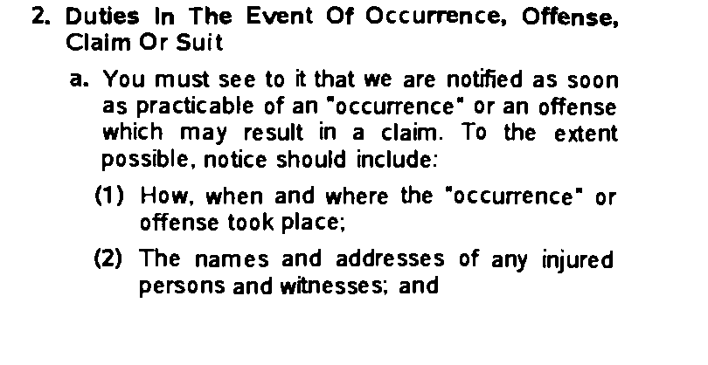
Love My tender

Slide 4
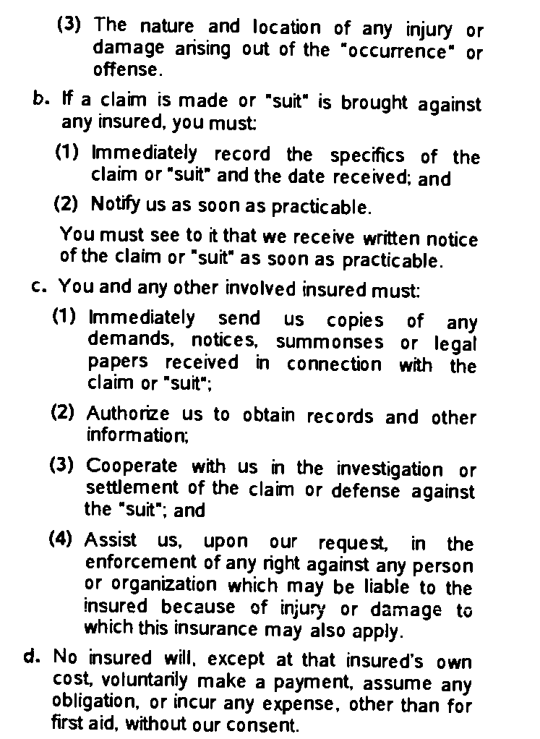
Love My Tender

Slide 5
Love My Tender
a. Defined. What is a potential claim? A visitor slips and falls on your sidewalk . . . a resident writes a letter to the board threatening to sue over a roof leak . . . a homeowner feels defamed over a newsletter article and sends an email to the board threatening to sue. These are potential claims as opposed to actual claims. A lawsuit has not yet been filed but could at some point in the future. Immediately putting the carrier on notice preserves the association's rights.

Slide 6
Love My Tender
If you become aware of an incident, notify your insurance company.
If you are sued, notify your carrier.
If you receive a summons, subpoena, motion, demand, settlement offer or other lawsuit papers, forward them to your carrier.
It doesn’t matter who’s right or wrong. Even if you are certain that the claim is unjustified or frivolous, report it anyway. False or frivolous accusations or even correctable errors still cost money to address and you may need your carrier’s assistance. You will definitely want the carrier’s assistance if a lawsuit results.

Slide 7
Love My Tender
b. Written vs. Oral. A verbal threat "You will hear from my lawyer!" is not considered significant enough to report to the insurance carriers. Most policies require that written threats of legal action be reported. Accordingly, whenever you receive a written threat of legal action, it should immediately report it.

Slide 8
Love My Tender
Who do I tender to?
My Carrier to preserve my coverage and rights and to obtain immediate defense.
Search for other coverage in contracts, purchase orders and agreements.

Slide 9
Love My Tender
In a tender letter, a party should lay out the basis for the tender, including specific citation to contractual provisions, common law or statutes and include a copy of the relevant contract, if applicable. The language in the letter should mirror that of the contractual provision relied upon and/or law on which the tender is based, but should always request full indemnity as to any settlement, judgment or other expenses, as well as request the immediate defense of any claim or lawsuit.

Slide 10
Love My Tender
On behalf of ( contractor A ) we are hereby tendering to (Contractor B ) and ( B’s Insurance Carrier) its defense in the lawsuit currently pending in the Circuit Court of Cook County, Illinois. This tender is being made pursuant to the status of Contractor A as an additional insured under ( Insurance company B) issued to ( subcontractor B).

Slide 11
Love My Tender
This tender is made to ( Insurance company B] without recourse to [contractor A’s] own policy of insurance with [Insurance company A] except as standby coverage should [Subcontractor B] not fulfill its obligations pursuant to its insurance coverage. It is the expressed intention of [Contractor A] that it be provided with insurance coverage for the [lawsuit] solely though the insurance policy issued to [Subcontractor B] by [ Insurance Company B].

Slide 12
Love My Tender
On behalf of [Contractor A] we hereby request all benefits available to [Contractor A] from [Insurance company C] including the right to a defense and indemnity in the [lawsuit] currently pending in the Circuit Court of Cook County Illinois. This request/tender is being made pursuant to [Contractor A’s ) status as an additional insured under [Insurance company C’s] policy;
[Contractor A] is currently being defended under a reservation of rights by [Insurance Company B], [contractor B’s] carrier. The purpose of this letter is to obtain the additional benefits of a defense and indemnity from Insurer C in addition to the defense and indemnity being provided by [Insurer B]. This request/tender is made to [Insurer C] without recourse to [Contactor A’s] own policy of insurance with [Insurer A] except as standby coverage should [Contractor B] or [Contractor C] not fulfill their obligations pursuant to its insurance coverage.

Slide 13
Love My Tender
One of the few duties imposed on an insured is to establish that it is the insured of a policy of insurance issued by the insurer.
If in pre suit the tender may be made by contactor to contractor at similar level.
If in suit the tender should be by council assigned to defend.

Slide 14
Love My Tender
So what is all this fuss about
Managing the claim and preserving rights and coverage.
This is especially important in Illinois but still important in other states.
Outside Illinois the “other insurance provisions” will apply.

Slide 15
Love My Tender
Courts generally seem to agree that the intent is for the “additional insured” coverage to be primary. However, decisions as to priority based on the policy language, or the language of the contract promising indemnity, have gone both ways, especially in states which attempt to reach a decision on priority based on the particulars of the “other insurance” clauses at issue, rather than on the closeness of each policy to the risk.

Slide 16
Love My Tender
The issue is the “management” of the defense and any resulting indemnity.
If not managed it will not work out to your client’s benefit.
Report to all possible insurance and indemnity options available and tell each what you want.
Be sure you draft a contract that will give you access to the coverage you want!

