Slide 1
JOINT VENTURES
Joint Venture insurance solutions

Slide 2
Why Joint Ventures
    Size or complexity of project
    Surety Capacity
    JV partner client relationship / political connection
    Meet MWBE or other federal / state / local bidding requirements
    JV partner has unique skills
    Geographical location of project
    Meet aggressive schedule challenges
    Limit participants’ liability

Slide 3
Joint Ventures
So what is the big deal about Joint Ventures?
The ISO CGL policy definition of insured excludes Joint Ventures unless named in the Declarations. This is because underwriters want to know what the venture will do before adding it to the policy. A joint Venture is often formed to do unusual work or enter a new area or territory.
. Any organization you newly acquire or form, other than a partnership, joint venture or limited liability company, and over which you maintain ownership or majority interest, will qualify as a Named Insured if there is no other similar insurance available to that organization.
Joint and several liability. All partners are jointly and severally liable for the actions of the joint venture. If your partner takes a powder, you are on the hook for the whole enchilada.

Slide 4
Types of Joint Ventures
    Integrated Joint Venture
      Partners share all profits and losses in proportion to their % interest in the Joint Venture
      Partners share all resources and personnel
    Non-Integrated Joint Venture
      No sharing of profits or losses
      Each partner provides a specific scope of work and is responsible for the profits from such scope of work
      Each partner is solely responsible for their scope if work
      Example: a “shell” joint venture
    Combination Integrated & Non-Integrated Joint Venture
    Silent Joint Venture
      One or more of the partners is not disclosed

Slide 5
Joint Venture Insurance Goals
    Provide an efficient, integrated, cost effective insurance program
    Provide stable, long term insurance program
    Provide broad, comprehensive coverage for the JV
    Claim management services to manage / mitigate claims
    Loss Control services

Slide 6
Coverage
    General Liability
    Excess / Umbrella
    Auto Liability
    Workers Compensation
    Professional / Pollution
    Builders’ Risk
    Subcontractor Default

Slide 7
Project Specific Program
Benefits
    Liability claims tied to JV policy
    One claims adjuster
    Unified defense
    One source for certs
    Mutual coverage / limits
    Protect partner’s master programs
    Preserve workers compensation exclusive remedy defenses
    Prevent action – over claims
    Includes Work Comp Mod can be average of both members existing mod.

Slide 8
Project Specific Program
Project specific general liability policy includes the named insured joint venture, its partners, members, co-employees or volunteer workers while preforming duties related to the conduct of the named insured’s business.
A tail can be added to provide coverage for completed operations for the work of the venture and provide coverage to the partners of the venture.

Slide 9
Line Item Joint Venture
Benefits
    Costs
    Simple to accomplish
Concerns
    Coordination of coverage issue – non-current coverage or limits
    More than one policy responding – claim coordination and costs
    Who responds to a claim against the JV only?
    Exhaustion of limits
    How to charge premiums
    Unequal deductible exposures
    Opens door for action-over claims
    May lose workers compensation exclusive remedy defense
    Completed operations for the joint venture including defense costs

Slide 10
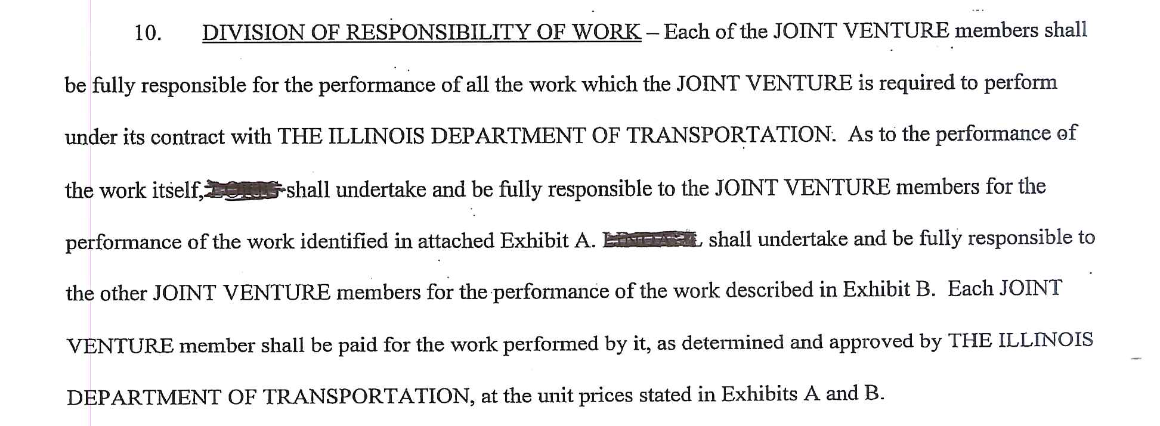
Example of Line Item J/V

Slide 11
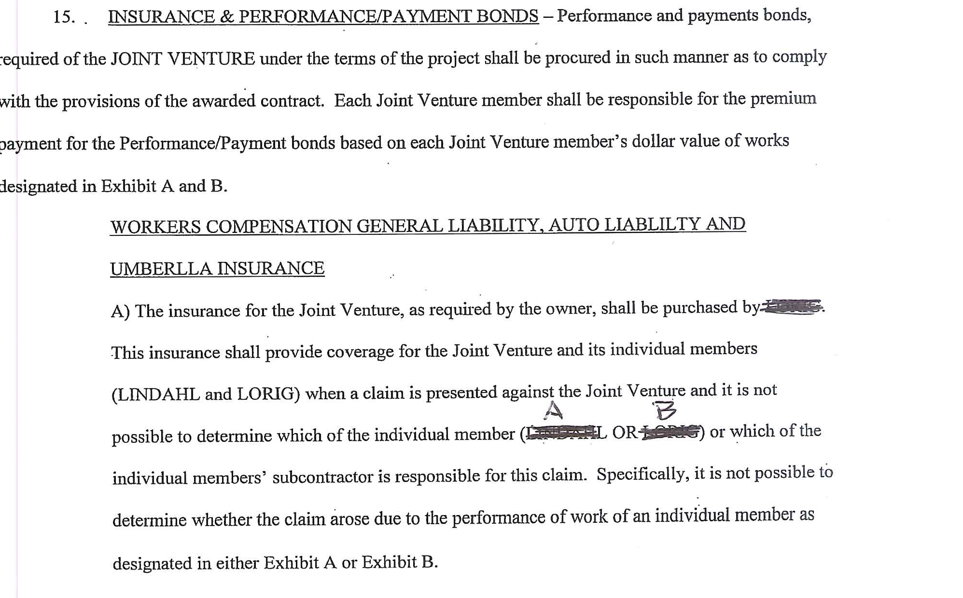

Slide 12
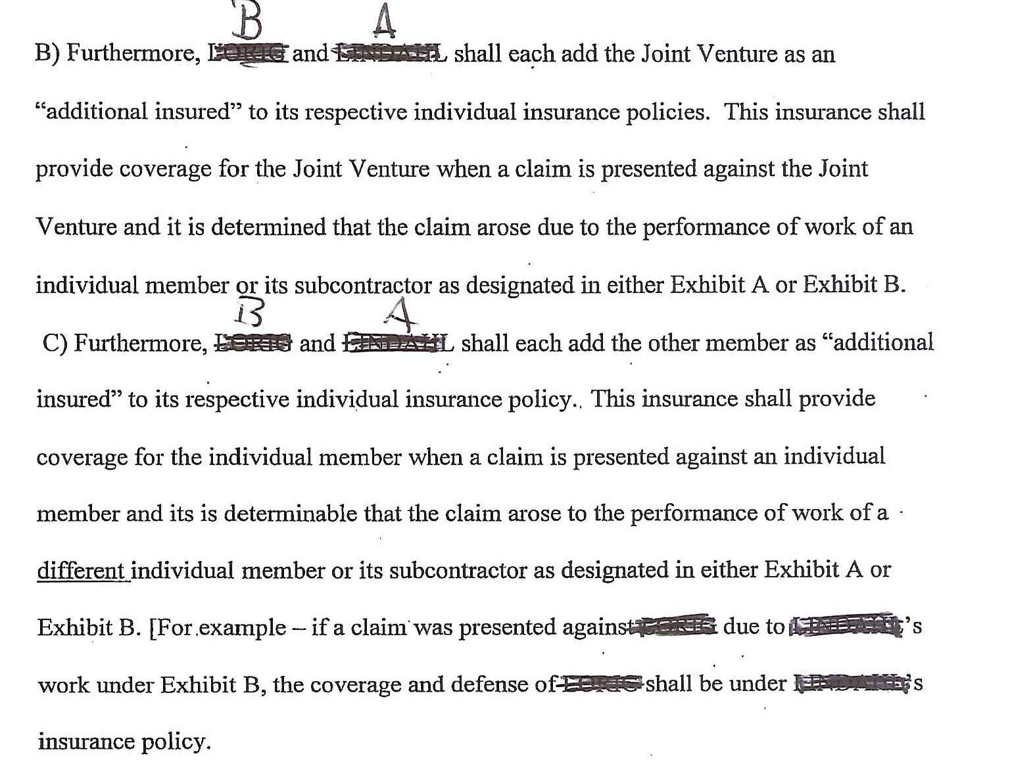

Slide 13
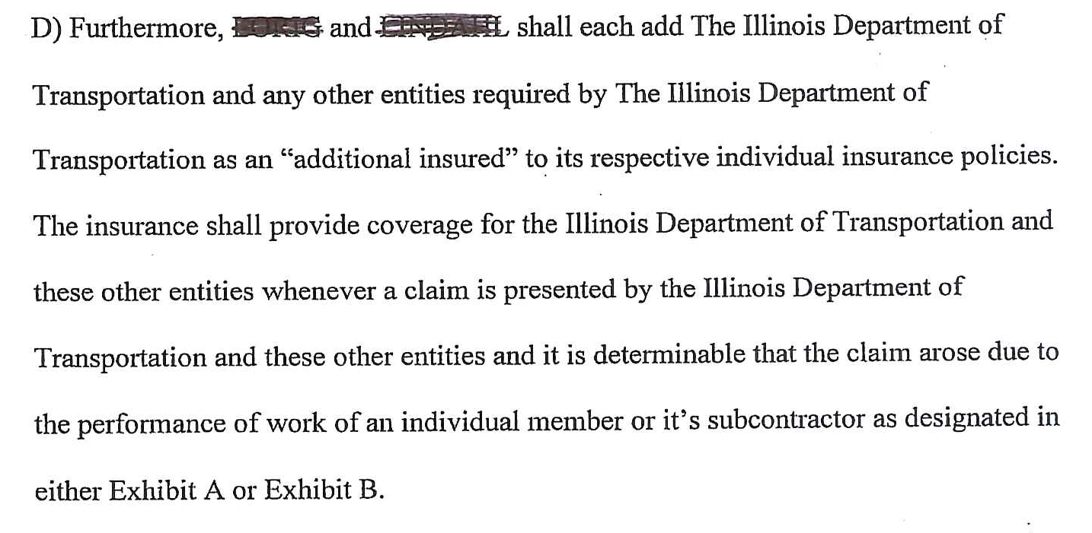

Slide 14
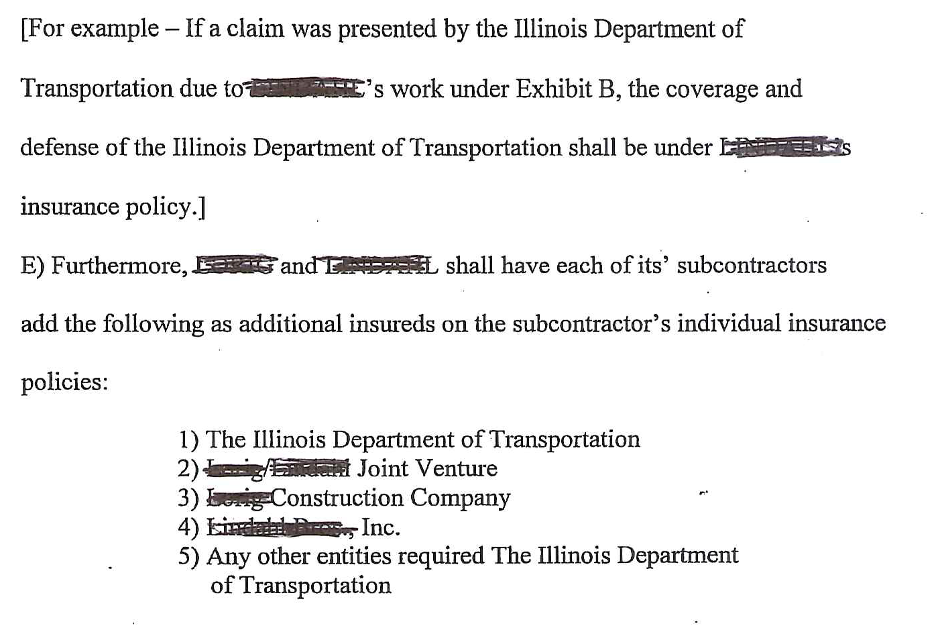

Slide 15
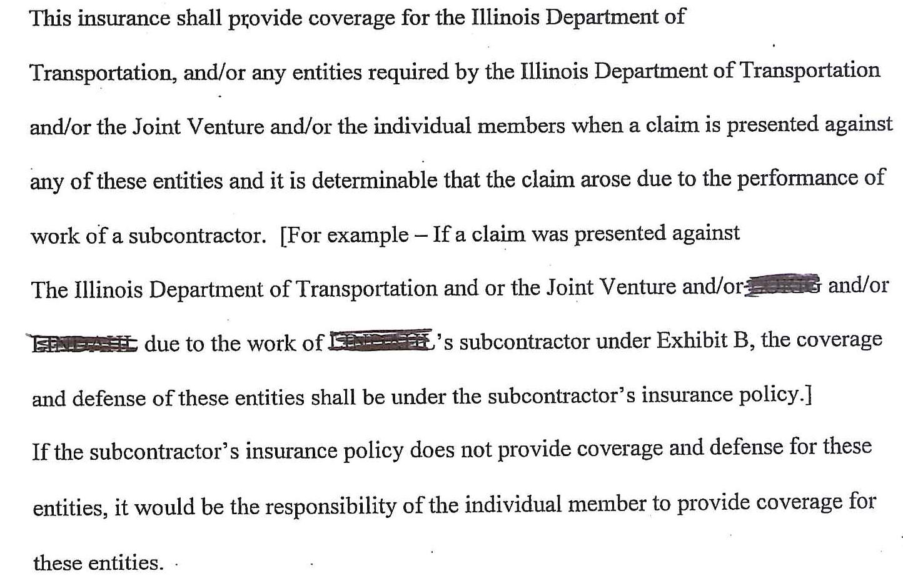

Slide 16
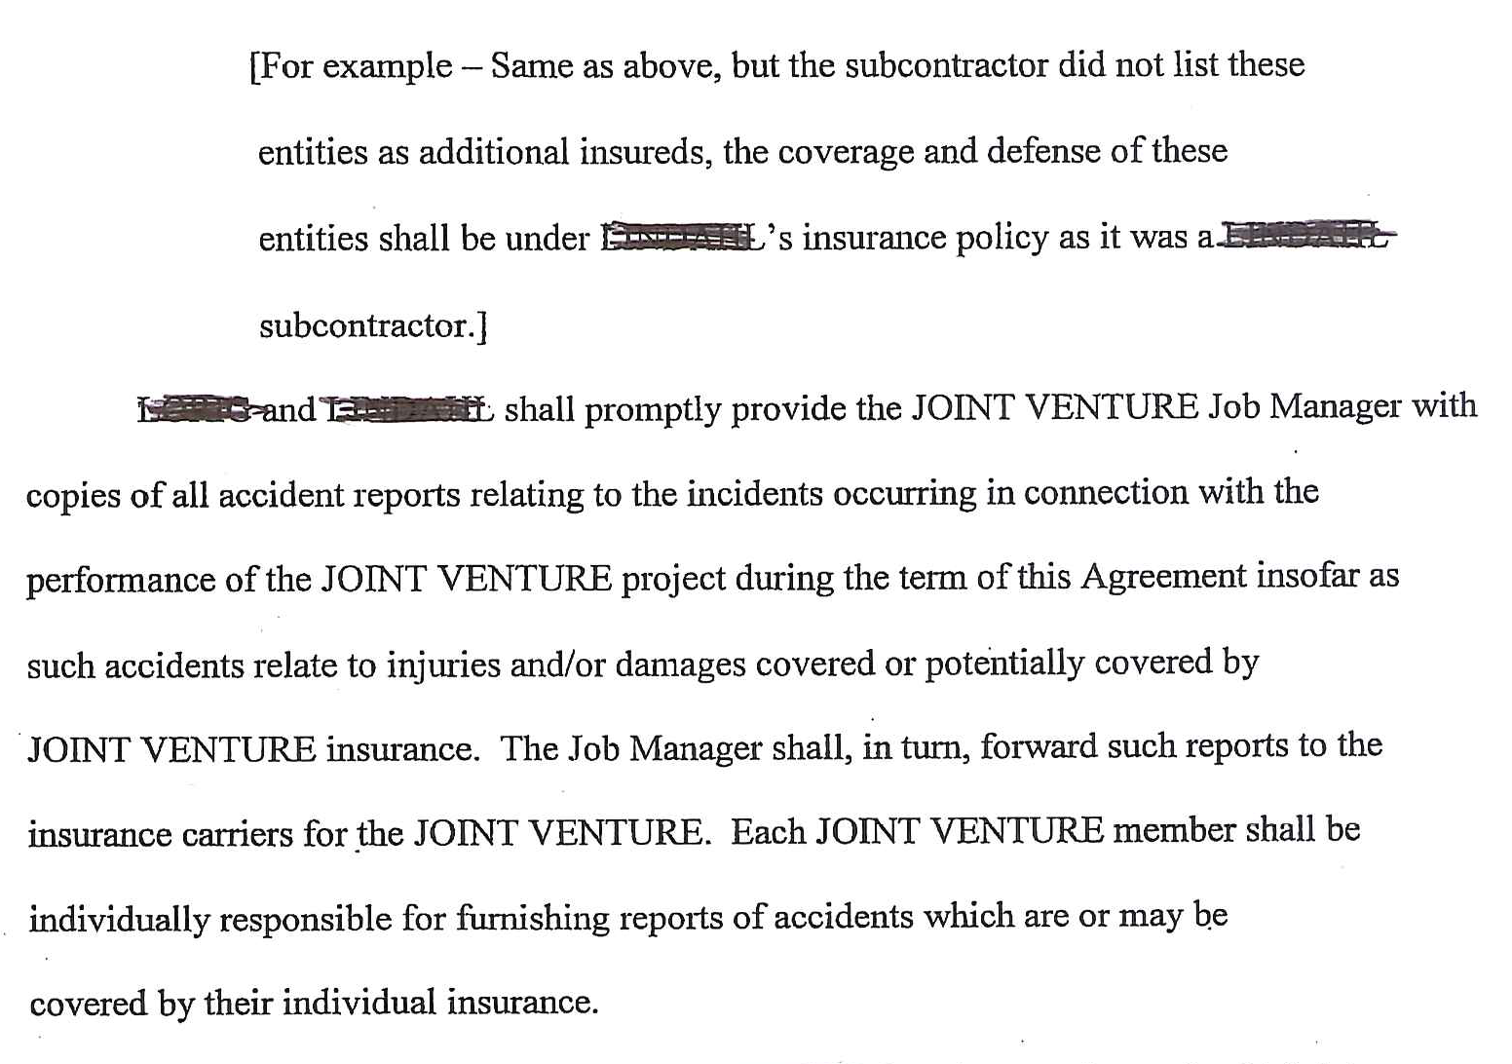

Slide 17
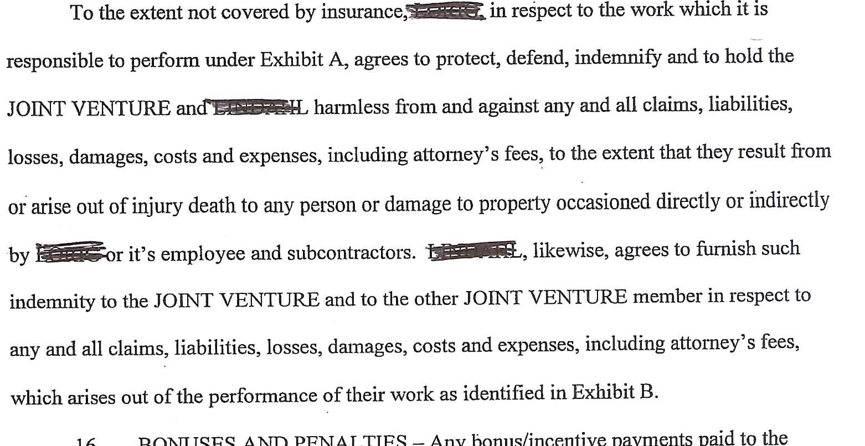

Slide 18


Slide 19
Add to Managing Partner’s Policy
Benefits
    Easy and fast
    Only one policy responds
    Unified defense
Concerns
    Managing partner’s limits are exposed to all JV claims
    Managing partner’s policy may not cover other partner(s) as additional insureds
    No completed operations coverage for minority partner.

Slide 20
Joint Venture Insurance
Do Nothing!

Slide 21
JV Administration
    Identify risks of the project
    Subcontract administration
    Subcontract certificates of insurance
    JV agreements
      Conflict Resolution - vote by % share or complete consensus. (What if lead partner wants to make a business decision best for the lead partner’s business but not best for the JV)
      Clearly outline the insurance structure and procurement responsibility in the JV Agreement
    Administration (auto ID cards, payroll, leased equipment from the partner to the JV)

Slide 22
How to decide what to do
Who preforms the work?
1) The joint ventures employees preform most of the work.
2) The joint venture partners preform the work or sublet the work.
This is a line item joint venture.
3) the joint venture sublets the work directly to subcontractors.

Slide 23
Completed Operations
What is different about completed operations coverage?
1) A dedicated join venture policy should include a tail until the tolling of the stature of limitations.
2) If added to the policy of one of the venture partners it must remain scheduled on both partners primary policies until tolling of the statute.
3) A line item joint venture requires all partners to continue to name the joint venture until statute of limitations or repose.
4) Can you get completed operations coverage for “your interest” in prior joint ventures? And don’t forget the excess coverage too. Even if its follow form!

Slide 24
Completed Operations
EXHIBIT VII.D.6
COMPLETED OPERATIONS COVERAGE FOR PAST JOINT VENTURES
The following is added to Section II—Who Is an Insured:
5. With respect to the "products-completed operations hazard," you are an insured for your liability arising out of the conduct of the partnerships(s) or joint venture(s) listed in the schedule below. This coverage will not inure to the benefit of any party except you.
Insured Partnerships/Joint Ventures:
___________________________________
___________________________________
___________________________________

